Slide 1



Session 14
Review and
Proficiency Examinations

Slide 2

Learning Objective
Demonstrate knowledge and proficiency in administering SFSTs

Slide 3
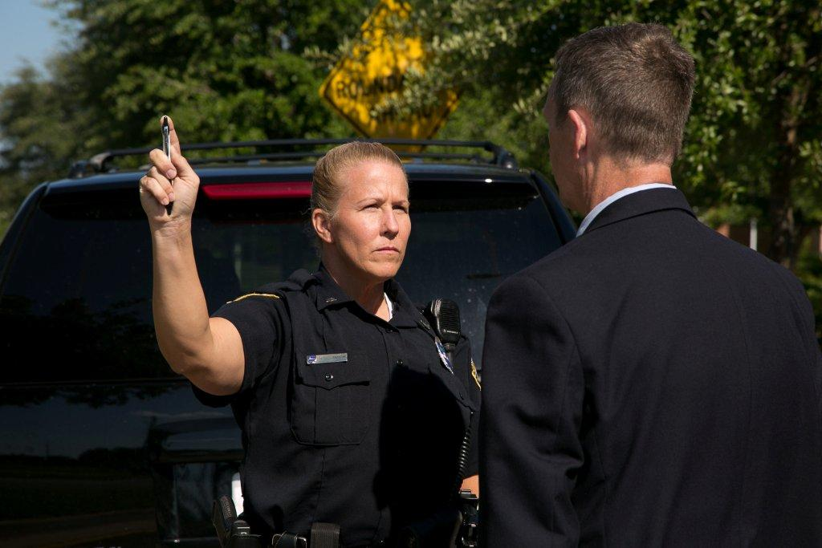
Horizontal Gaze Nystagmus Review
Involuntary jerking of the eyes, occurring
as the eyes gaze to the side

Slide 4
Three Clues of Horizontal Gaze Nystagmus
Lack of Smooth Pursuit
Distinct and Sustained Nystagmus at Maximum Deviation
Onset of Nystagmus Prior to 45 Degrees

Slide 5

Clue Number 1
Lack of Smooth Pursuit

Slide 6
Clue Number 2
Distinct and Sustained Nystagmus
at Maximum Deviation

Slide 7

Clue Number 3
Onset of Nystagmus Prior to 45 Degrees

Slide 8
Administrative Procedures
Eyeglasses
Verbal instructions
Feet together, hands at sides
Head still
Look at stimulus
Follow movement with eyes
Position stimulus (12-15 inches)(30-38 cm)
Pupil size and Resting Nystagmus
Equal Tracking

Slide 9
Administrative Procedures
Check for Lack of Smooth Pursuit
Check for Distinct and Sustained Nystagmus at Maximum Deviation
Check for Onset of Nystagmus Prior to 45 Degrees
Total the clues
Check for VGN

Slide 10
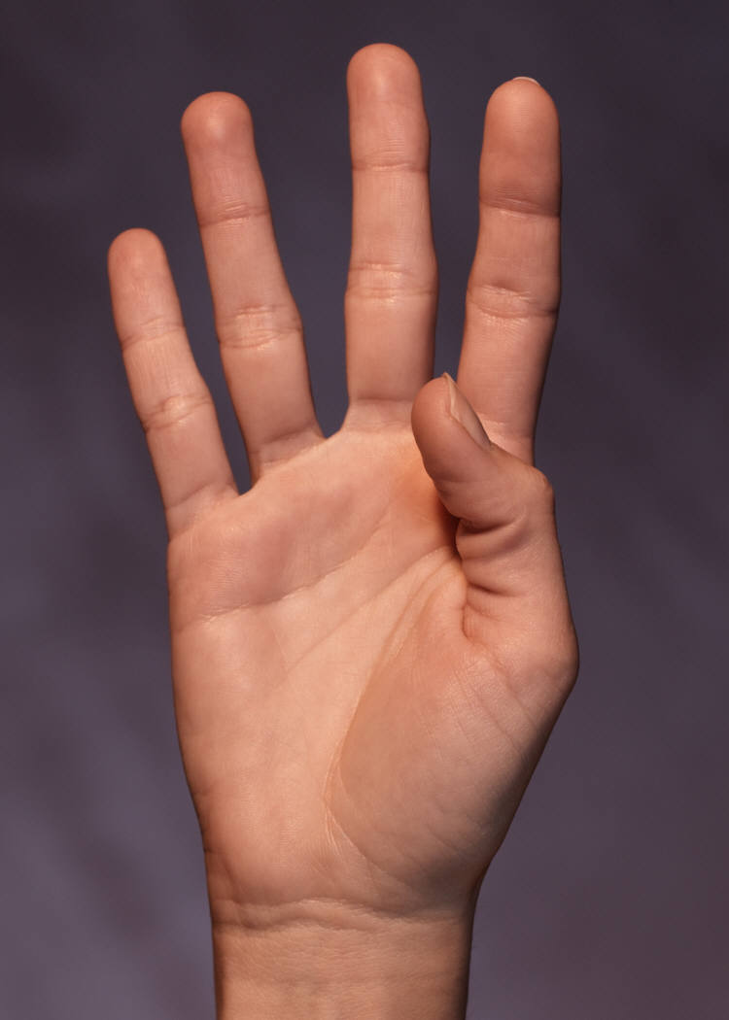
Horizontal Gaze Nystagmus Test Criterion
4 or more clues indicates BAC
above 0.08 (88% accurate)

Slide 11
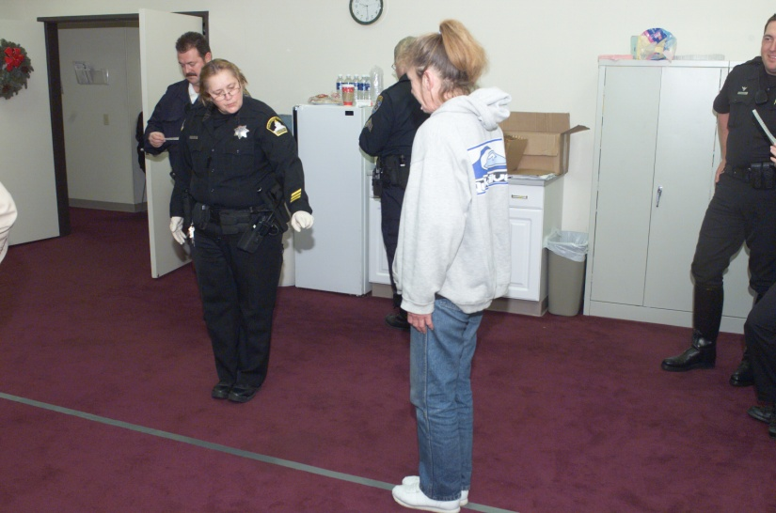
Walk and Turn
Divided Attention
Mental Task and Physical Task
Instruction stage
Walking stage

Slide 12
Administrative Procedures
Verbal instructions:
Assume heel-to-toe stance
Arms down at sides
Don’t start until told
9 heel-to-toe steps turn, 9 heel-to-toe steps
Turn procedures:
Turn around on the line
Several small steps

Slide 13
Administrative Procedures
While walking:
Keep watching feet
Arms down at sides
Count steps out loud
Don’t stop during walk

Slide 14
Walk and Turn Test Clues
Cannot keep balance
Starts too soon
Stops while walking
Does not touch heel-to-toe
Steps off the line
Uses arm(s) to balance
Improper turn
Incorrect number of steps

Slide 15
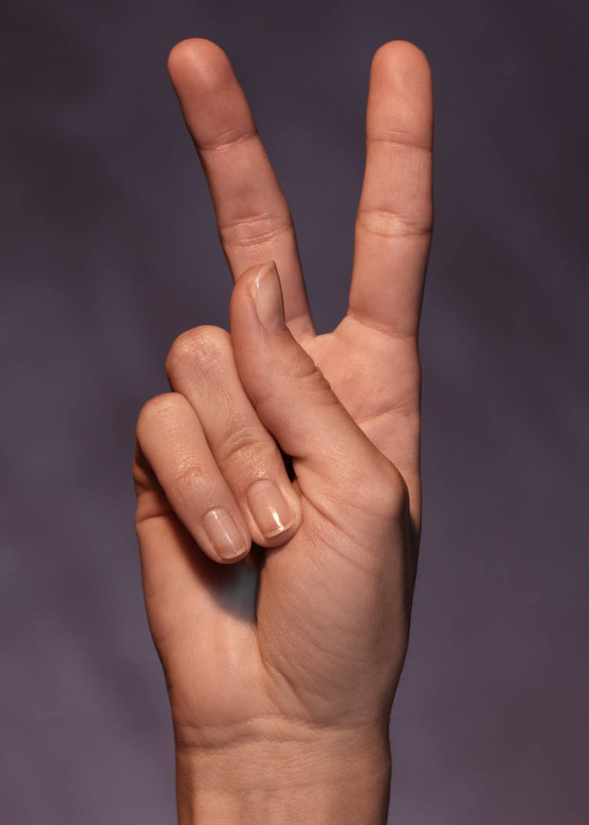
Walk and Turn Test Criterion
2 or more clues indicates BAC
above 0.08 (79% accurate)

Slide 16
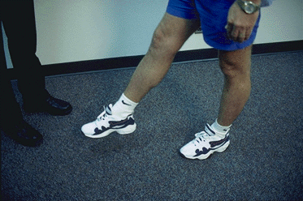
One Leg Stand
Divided Attention Test
Mental Task and Physical Task
Instruction stage
Balance and counting stage

Slide 17
Administrative Procedures
Instruction stage:
Stand straight, feet together
Keep arms at sides
Maintain position until told otherwise

Slide 18
Administrative Procedures
Balance and counting stage:
Raise either leg
Keep raised foot approximately six inches (15 cm) off ground, foot parallel to the ground
Keep both legs straight and arms at your side
Keep eyes on raised foot
Count out loud in the following manner: “One thousand one, one thousand two, one thousand three and so on”, until told to stop

Slide 19
One Leg Stand Test Clues
Sways while balancing
Uses arm(s) to balance
Hopping
Puts foot down

Slide 20
One Leg Stand Test Criterion
Two or more clues indicates BAC above 0.08 (83% accurate)

Slide 21
Questions and Proficiency Examination

